Slide 1
0714 02 CSE 4103
Compiler Design

Slide 2
NFA

Slide 3
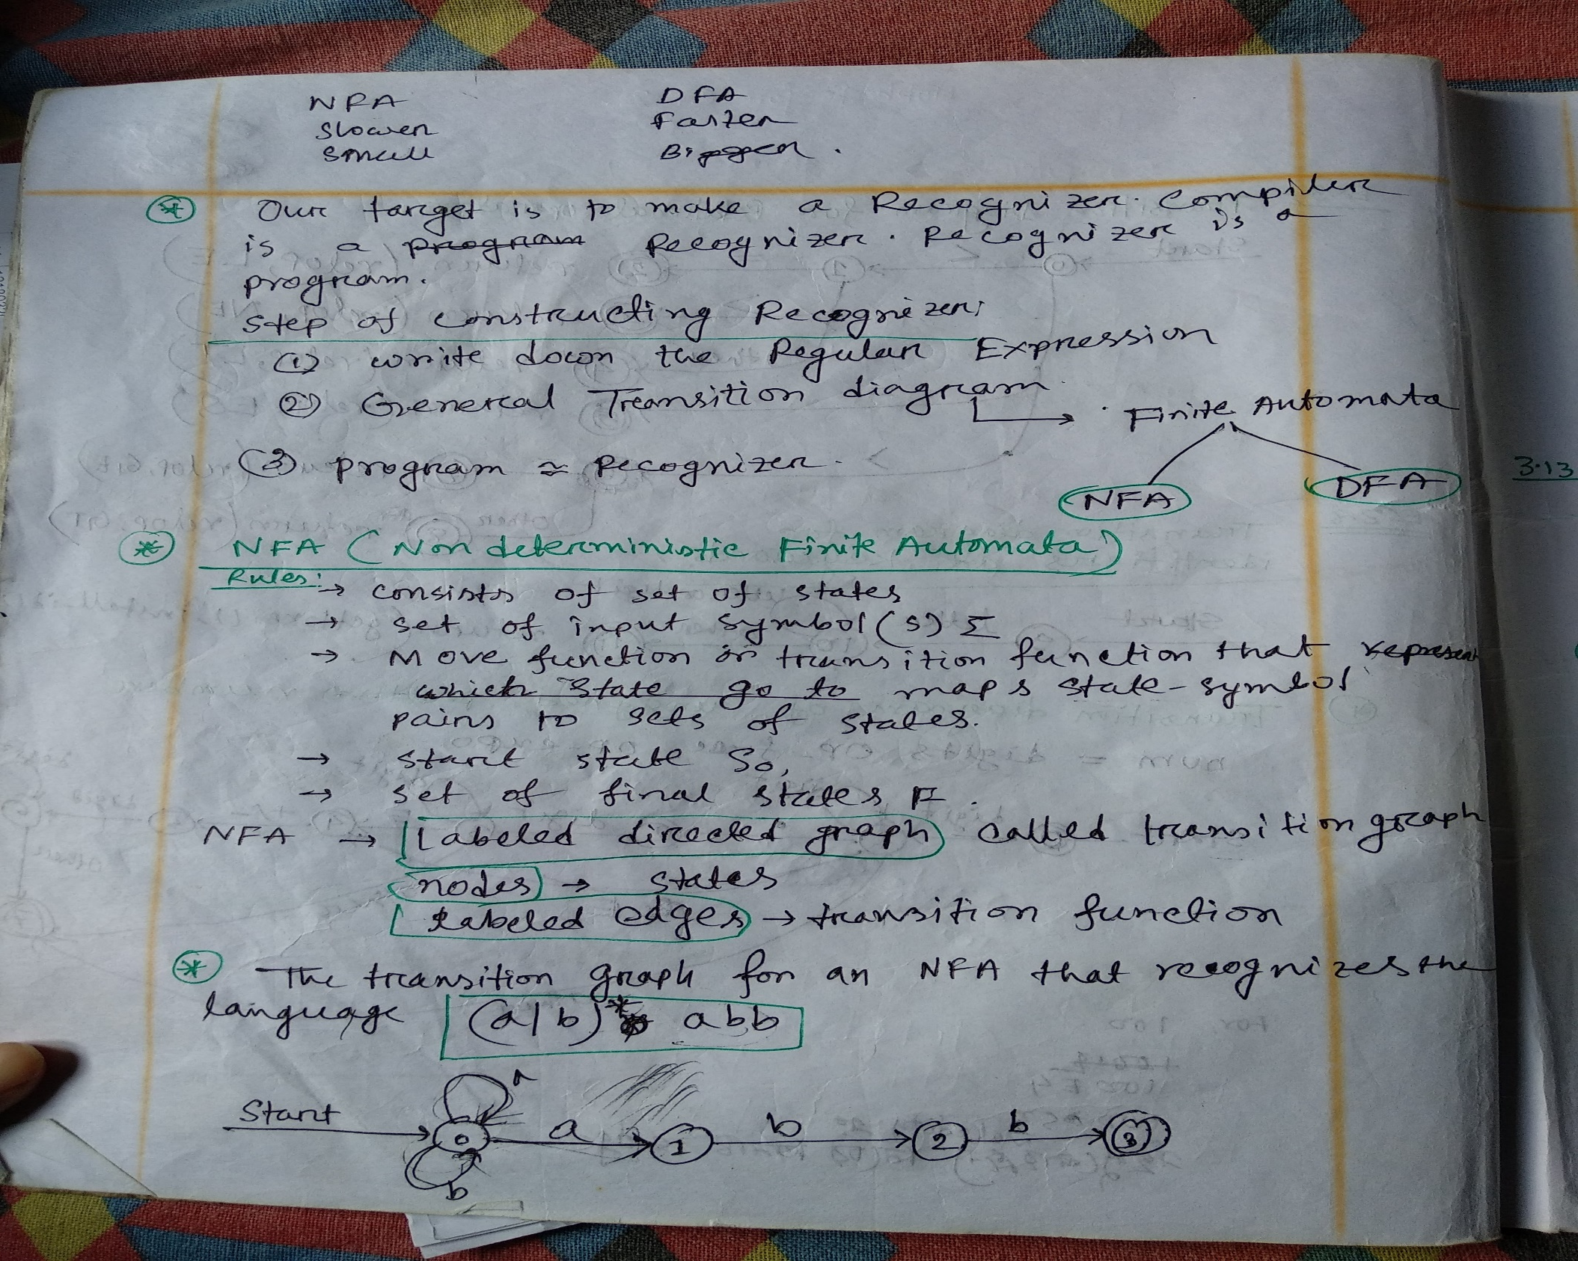

Slide 4
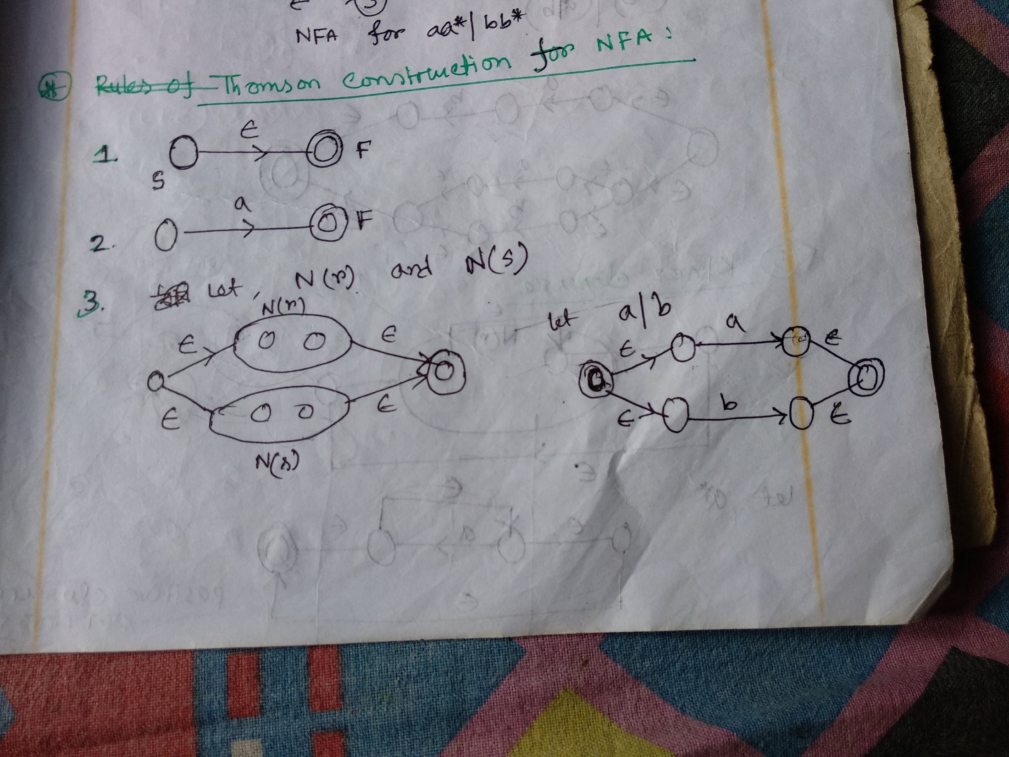

Slide 5
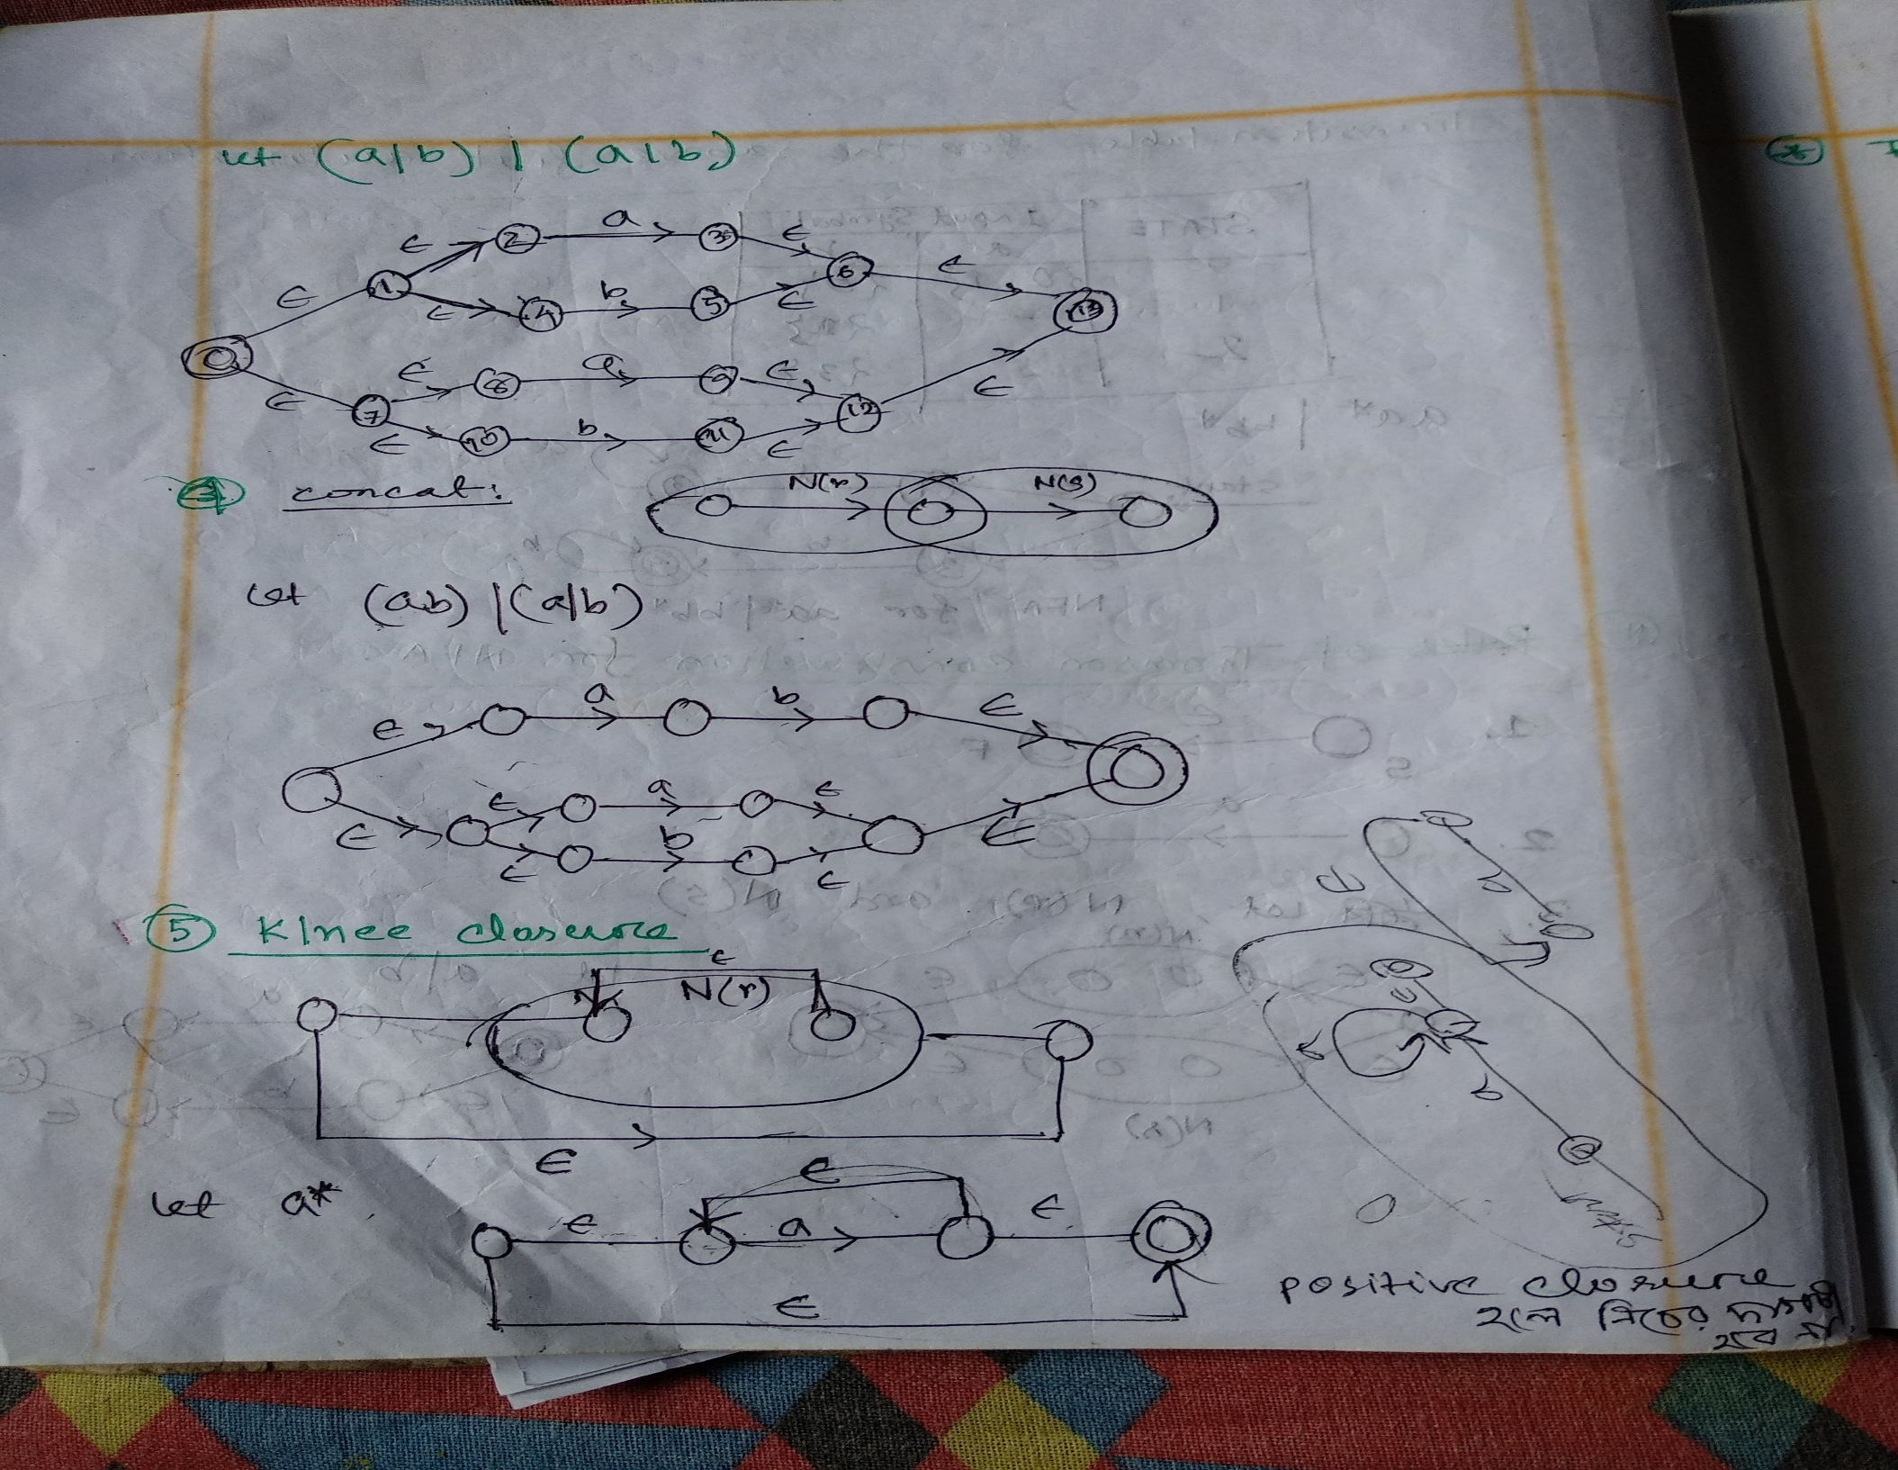

Slide 6
Thank You

